Slide 1

Mini Project Presentation On Farmer Varmer Website
Presented By:-
Amit Shakya(161500073)
Amit Ojha (161500074)
Ankit Kumar (161500088)
Anmol Gupta (161500100)

Slide 2
What is Online Shopping ?
The online selling of or enabling
the sale of products or services to
consumers.

Slide 3
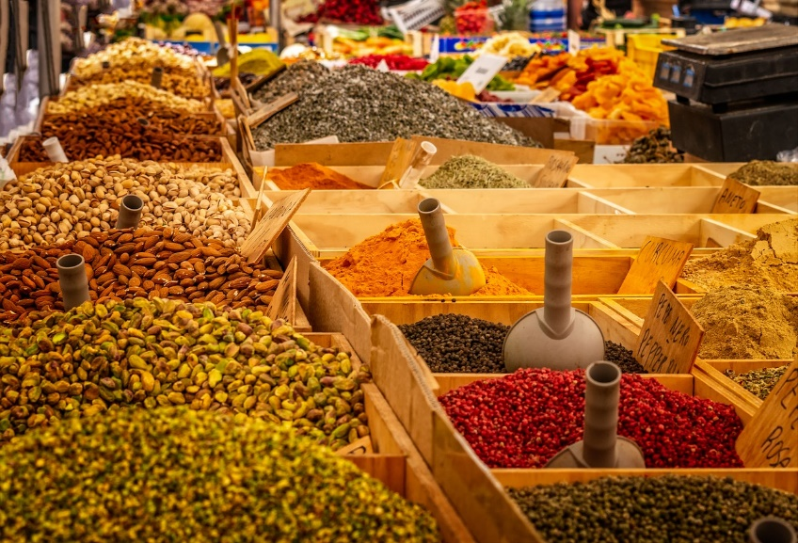
Overview
Introduction
Requirement
Benefits To Online Shopping
Screen Shots Of Site
Advantage Of Online Shopping
Disadvantage Of Online Shopping
Future Scope
Conclusion
References

Slide 4

Introduction
Shopping is one of the essential part of our daily life. We're using different types of shops to buy different kind of things everyday.
Online shopping or e-shopping is a form of electronic commerce which allows consumers to directly buy goods or services from a seller over the Internet using a web browser.

Slide 5
Requirement
Software :
Windows OS : XP/7 /8 /8.1 or Mac OS
Linux
Browser like (Chrome, Mozila, IE)
Oracle Database
Hardware:
Processor: Pentium or Higher
RAM : 1GB or Higher.

Slide 6
Benefits to Website
Usability and easy access
Better deals and savings rewards
Convenience
Larger stock to choose from
Product reviews
Comparison shopping

Slide 7
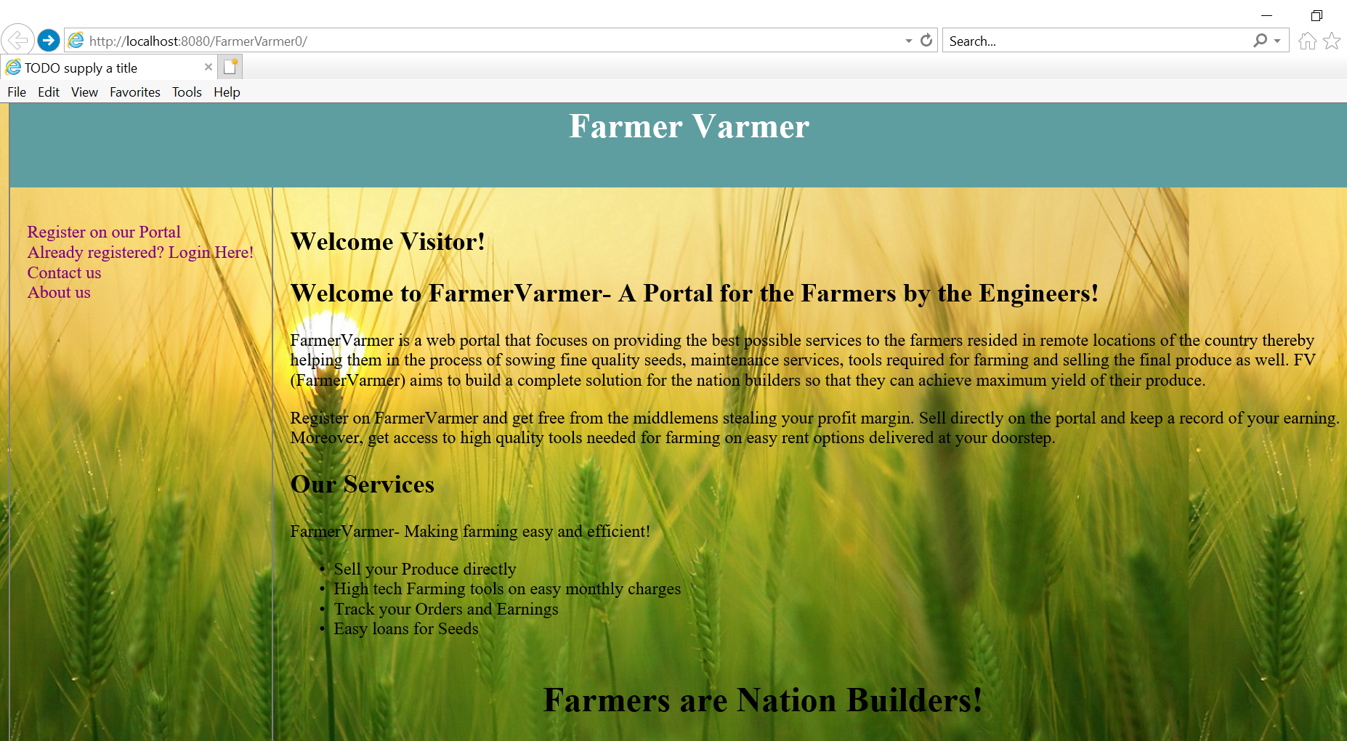
ScreenShots:-

Slide 8
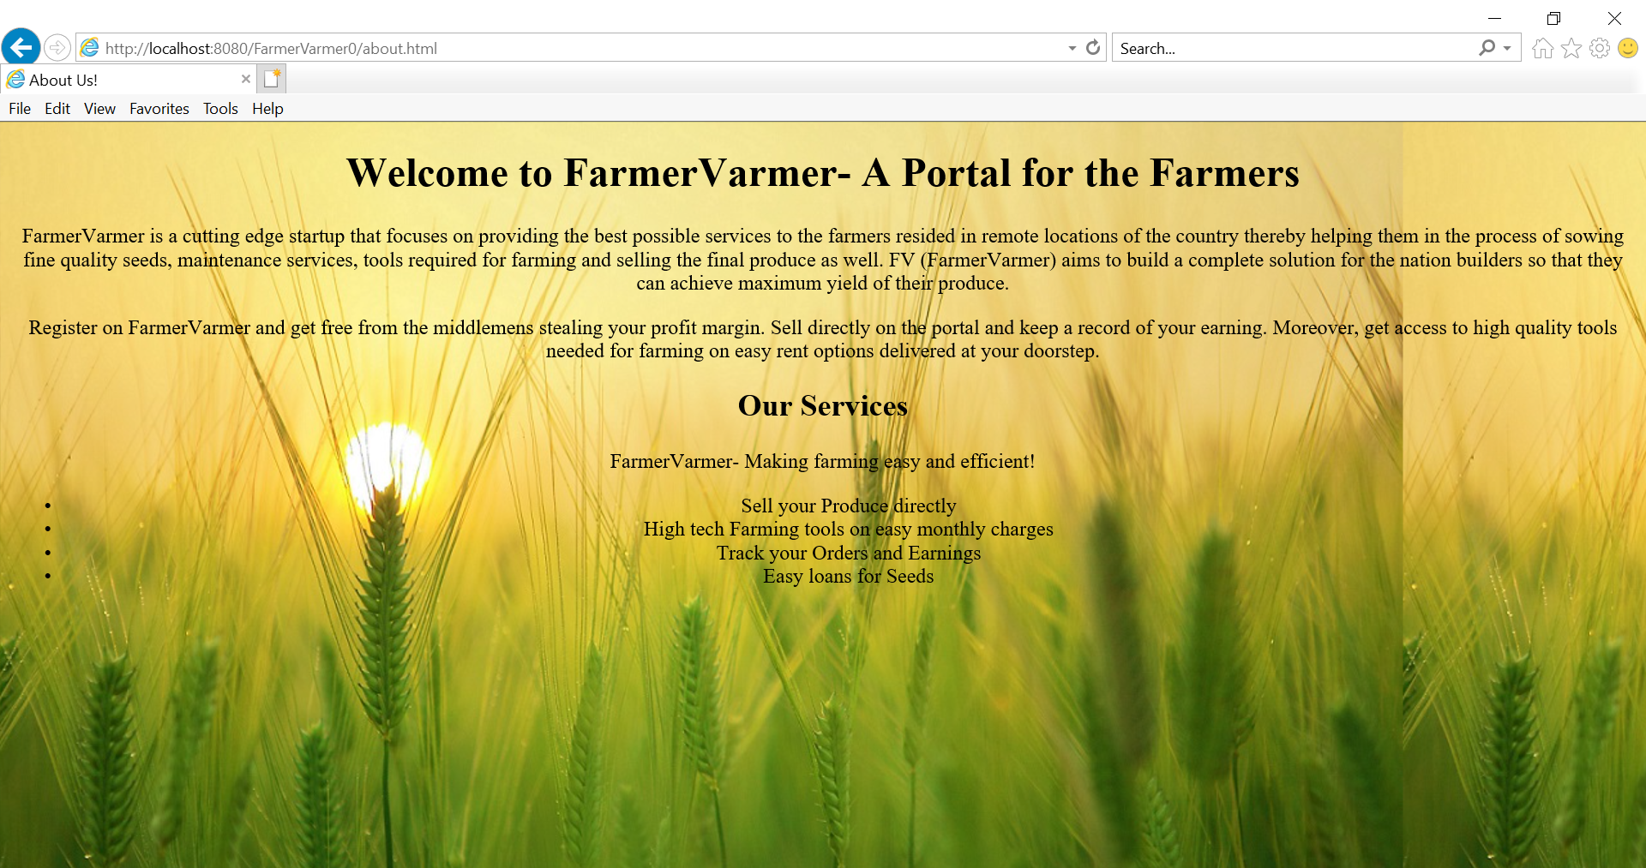
About Us Page:-

Slide 9
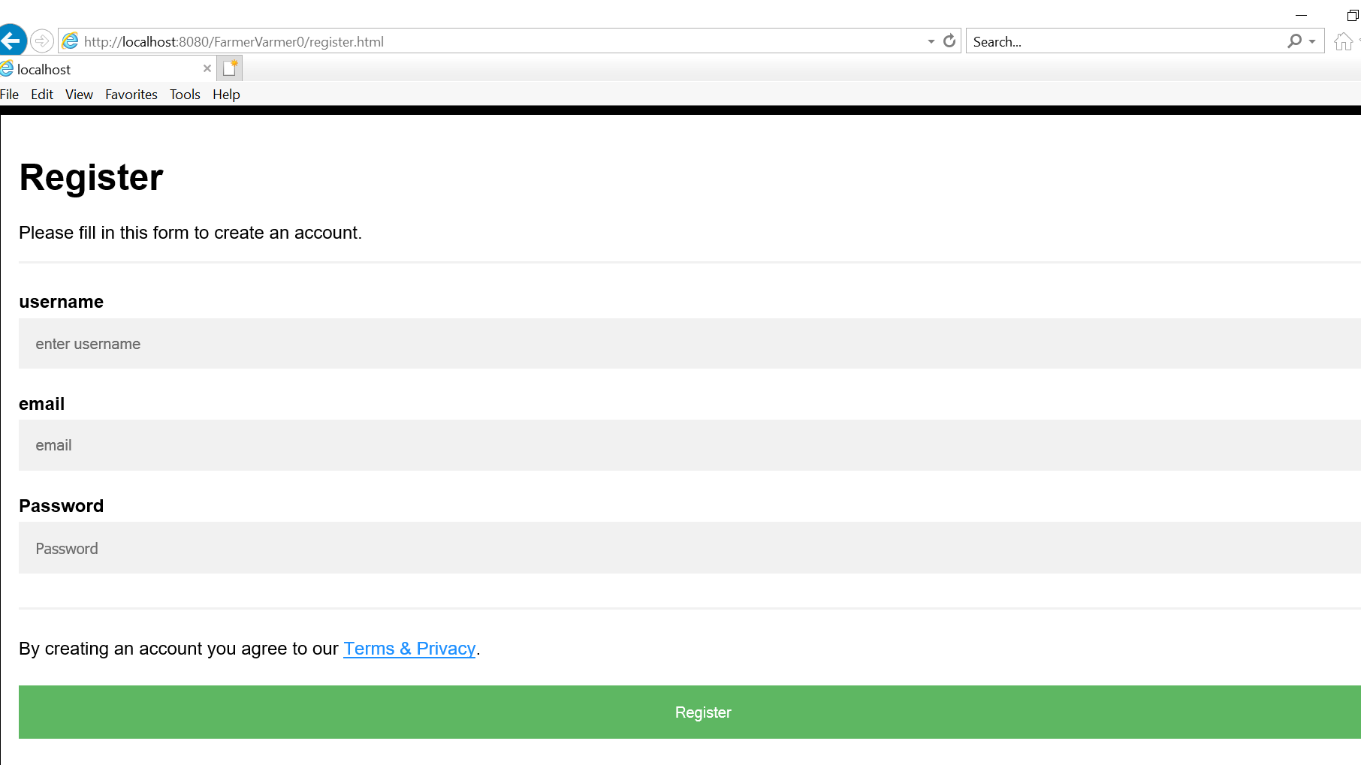
Registration form:-

Slide 10
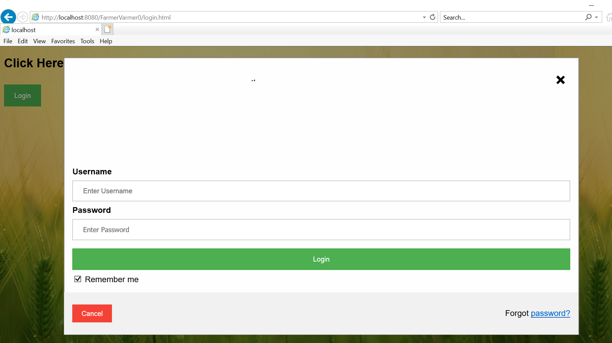
Login form:-

Slide 11
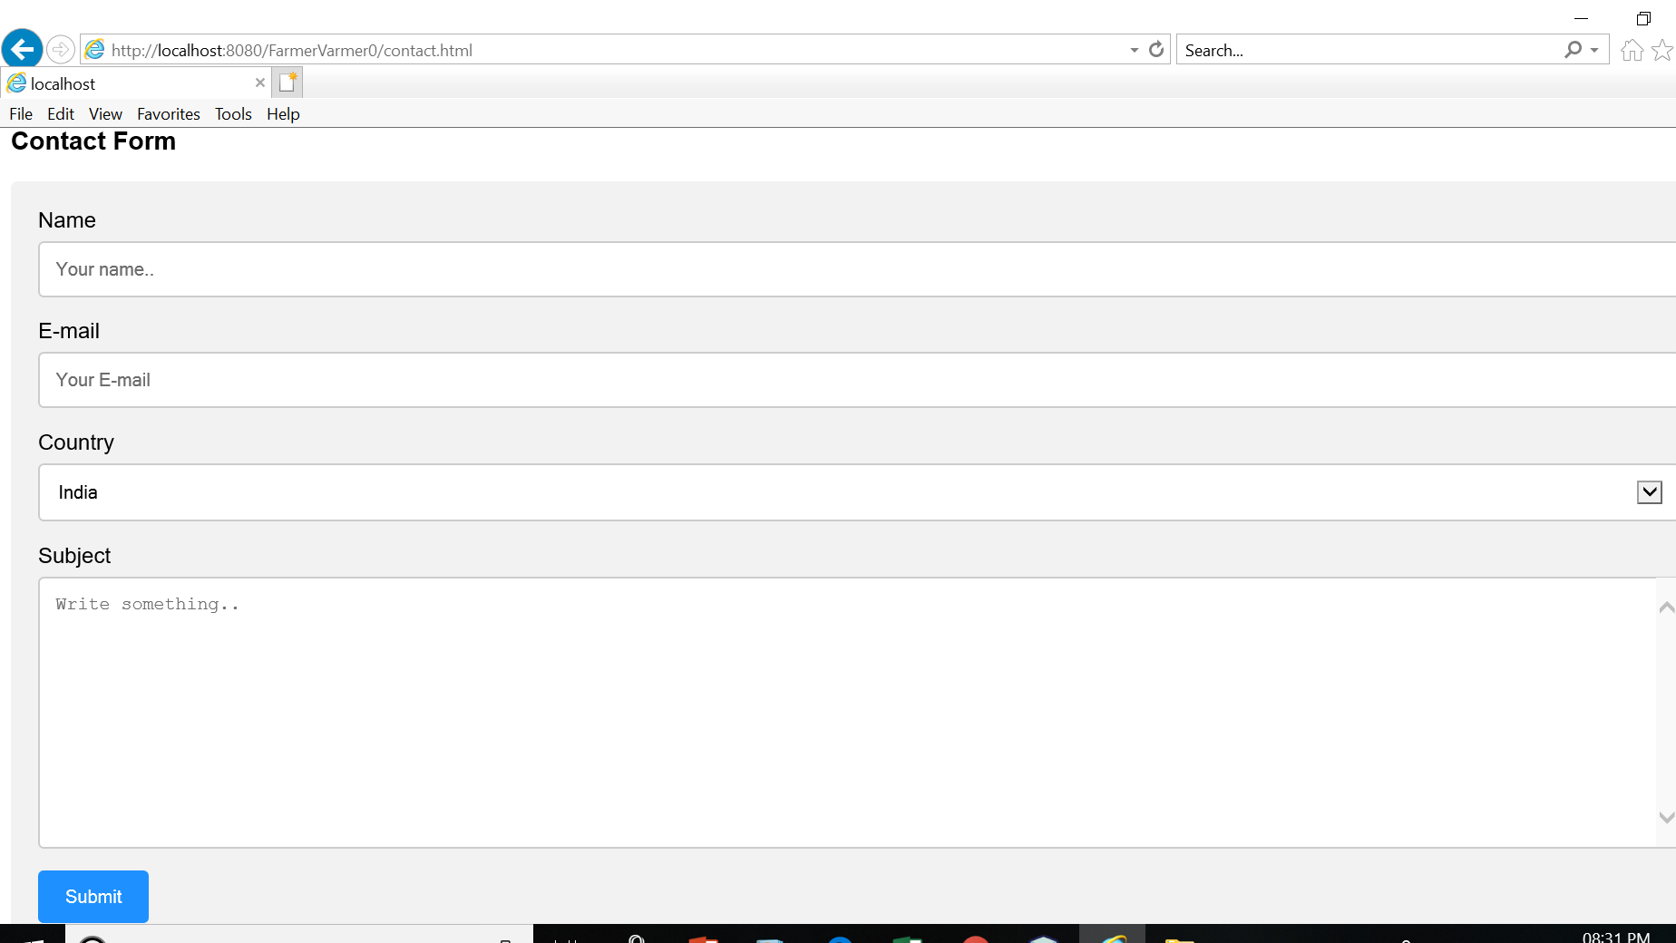
Contact Us form:-

Slide 12
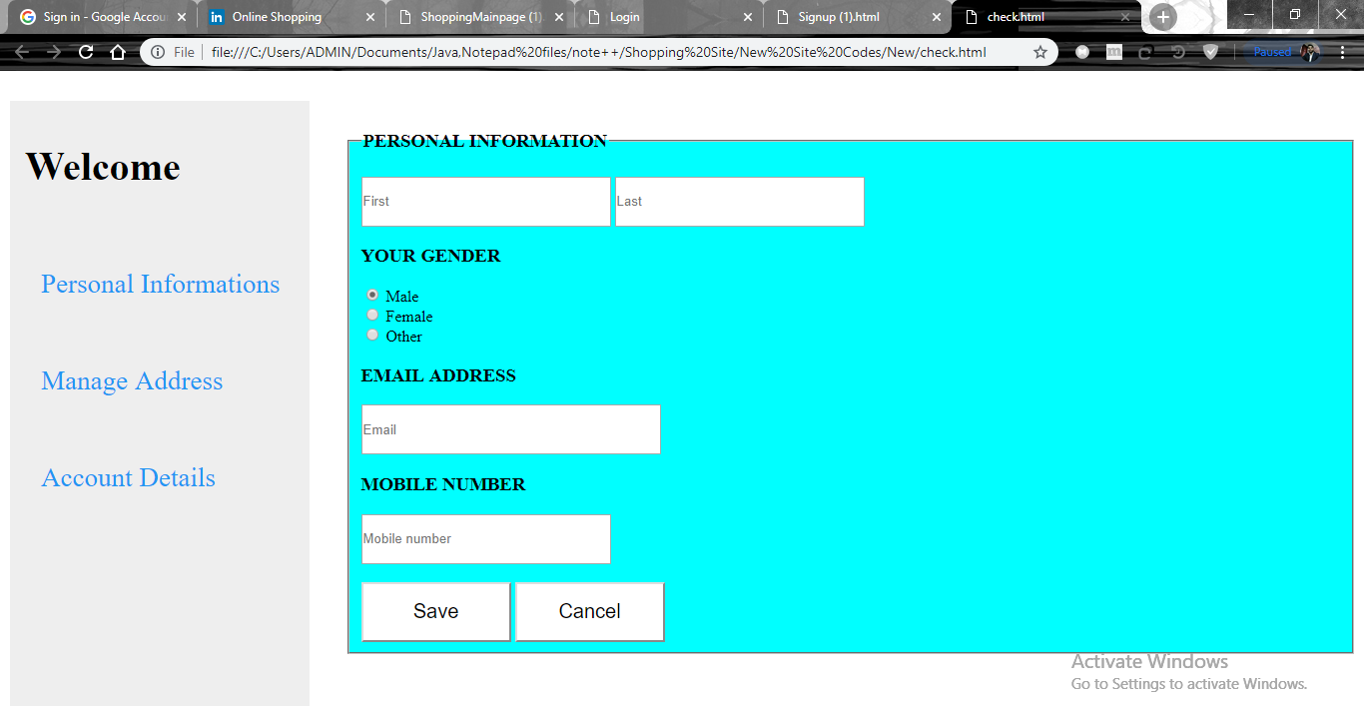
Personal Information

Slide 13
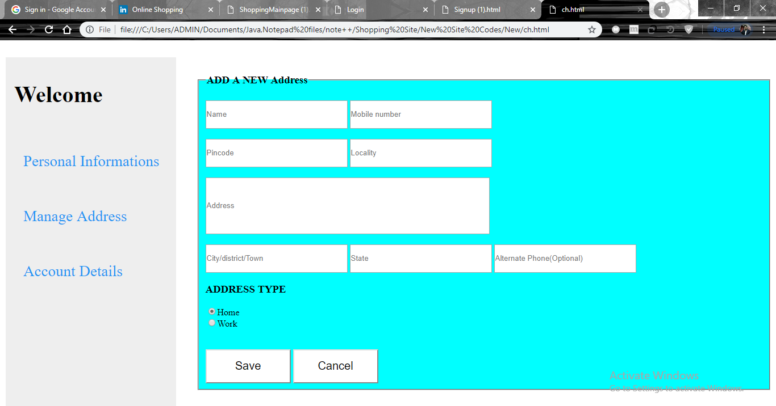
Manage Address

Slide 14
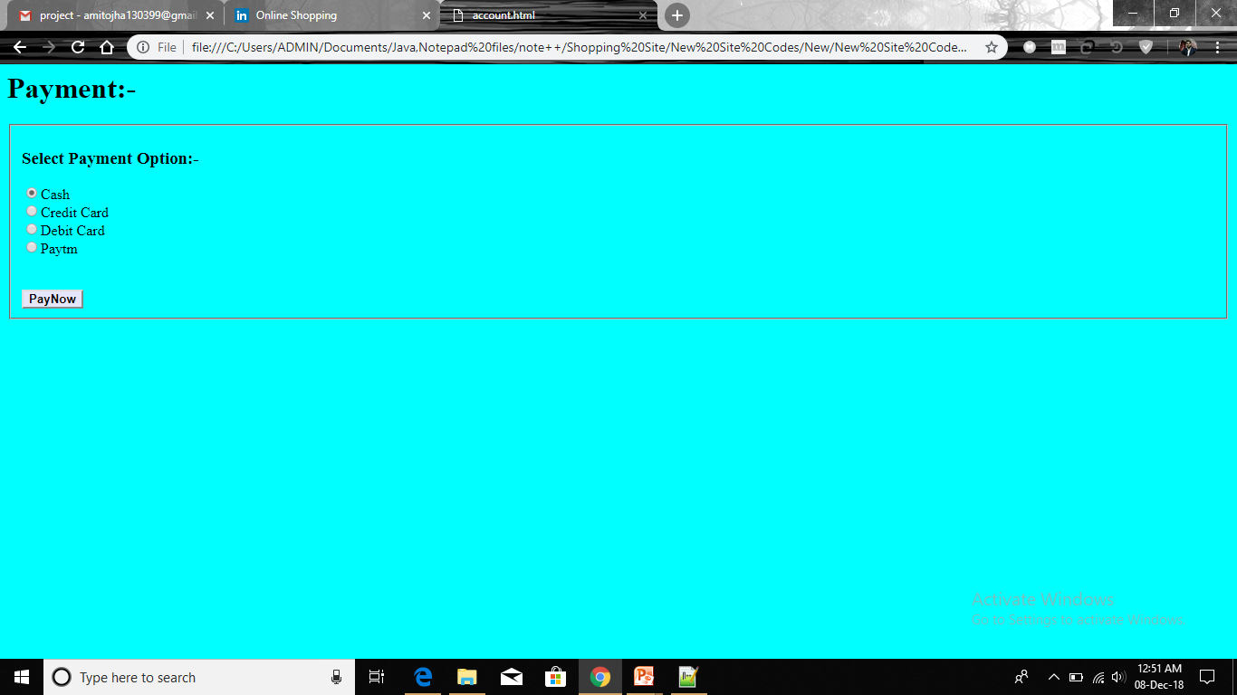
Payment option

Slide 15
Advantages of Online Shopping
Convenience: One of the biggest benefits of online shopping is that you can buy almost anything you could imagine without ever leaving your house.
Selection: stores are able to carry more selection than traditional brick-and-mortar stores.
Information: shops tend to provide more information about items for sale than you would get in a physical store(unless you asked a sales associate).

Slide 16
Disadvantage Of Online Shopping
Hands-On Inspection: One thing that online shopping can’t replace is the experience of actually seeing and touching the item you are considering buying.
Shipping: Some major online retailers now offer free shipping for their products, but many require you to meet a minimum order cost to qualify.

Slide 17
Future Scope
The project made here is just to insure that the product could be valid in today’s real world.

Slide 18
Conclusion
Online shopping is the best way to purchase any item but be careful because there may be some fake products on different sites.
Only purchase those items which can be recognised easily that item is fake or not or choose according rating of buyers.
But not to worry, on my site you will get all items genuine and trusty, just check once here before buy anywhere.
The Online Shopping Megastore Spend For Quality.

Slide 19
References
http://www.w3school.com
https://www.youtube.com
https://www.javatpoint.com

Slide 20
Thank you

